Slide 1
Mobile & Wireless Technology CT090-3-2 & Version 2
Troubleshooting and Maintaining Wireless Networks

Slide 2
Topic & Structure of The Lesson
Identifying Wireless LAN Problems
Software and Hardware Upgrades
Optimizing Wireless Networks
Infrastructure Hardware Selection and Placement
Identifying, Locating, and Removing Sources of Interference
Client Load Balancing
Analyzing Infrastructure Capacity and Utilization

Slide 3
Learning Outcomes
At the end of this topic, You should be able to
Recognize common problems associated with wireless networks and their symptoms, and identify steps to isolate and troubleshoot the problem.
Identify procedures to optimize wireless networks in specific situations

Slide 4
Key Terms You Must Be Able To Use
If you have mastered this topic, you should be able to use the following terms correctly in your assignments and exams:
Dynamic Host Configuration Protocol (DHCP)
Firmware
Hidden node
IP address
Load balancing
Modulation
Optimizing
Protocol
Receiver
Throughput
Transmitter

Slide 5
Identifying and Maintaining Wireless Networks
A first step in troubleshooting wireless LAN problems is to identify whether it is a global issue or an isolated problem. Global issues often include infrastructure devices and components.
Global problem usually involves many users or groups of users. Some of the wireless devices that can be related to a global problem include:
Access points
Bridges
Wireless controllers/switches

Slide 6
Identifying and Maintaining Wireless
Networks
In addition to wireless infrastructure devices, wired infrastructure components can also be a potential source for global problems.
Keep in mind that wireless devices usually require a wired infrastructure in order to pass information between infrastructure devices or outside the wireless network.
Devices and components that can contribute to wired infrastructure problems include:
Cabling
Switches
Routers
WAN connectivity

Slide 7
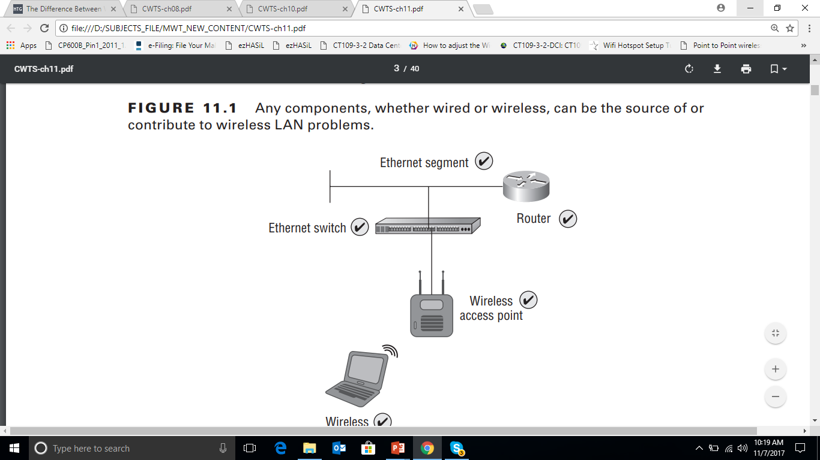
Global Problem

Slide 8
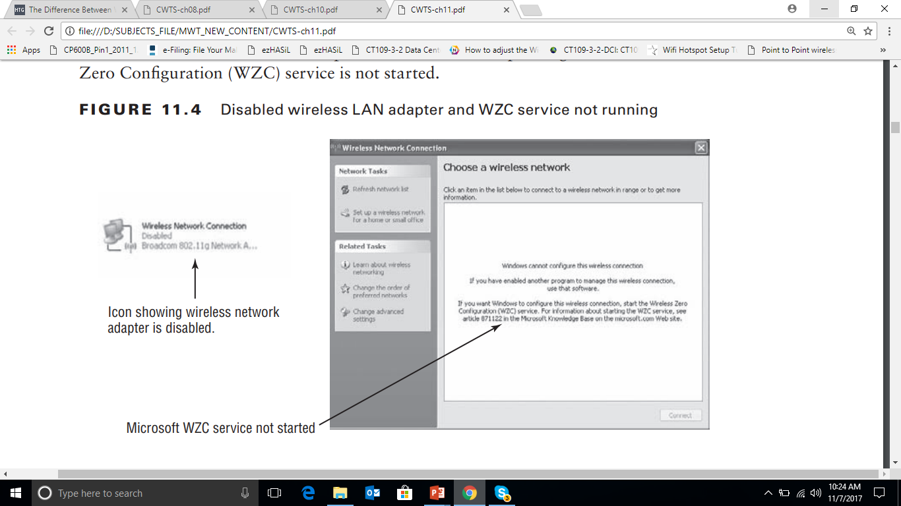
Local problem

Slide 9
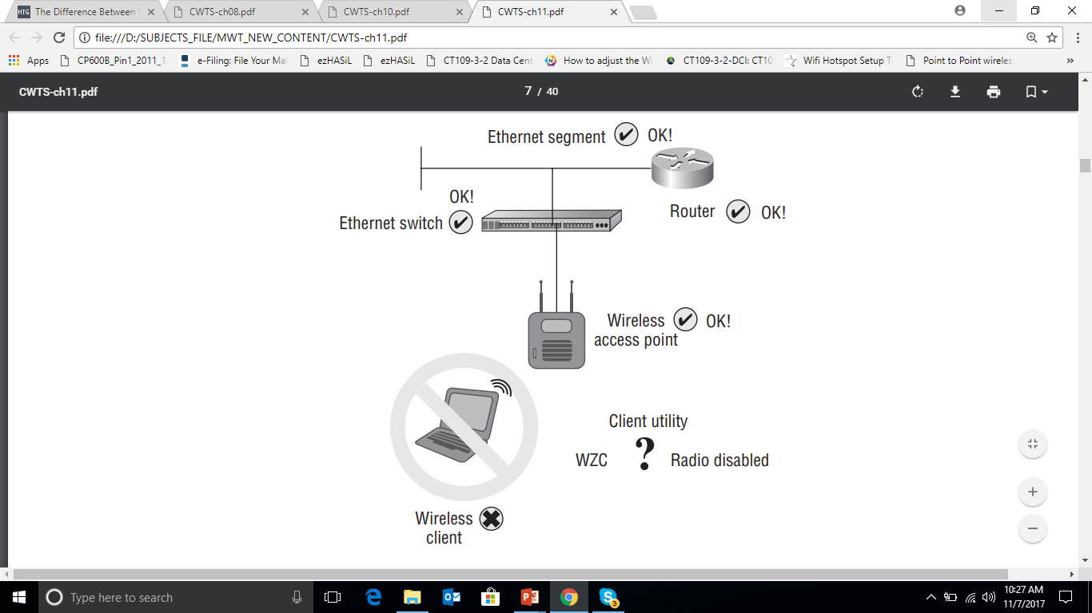
Local Problem

Slide 10
Identifying and Maintaining Wireless
Networks
Other Connectivity Issues
Security Settings : Incorrect security settings can also cause connectivity issues. For example, assume an access point is using WPA 2.0 personal mode for security.
If a wireless client device has the wrong passphrase or pre shared key entered, it will not complete the authentication process and will not have a valid Layer 3 TCP/IP address.
In this case, the network adapter would stay in the “Acquiring network address” state; it would not be able to complete the Layer 2 connection process and would not receive a valid IP address.

Slide 11
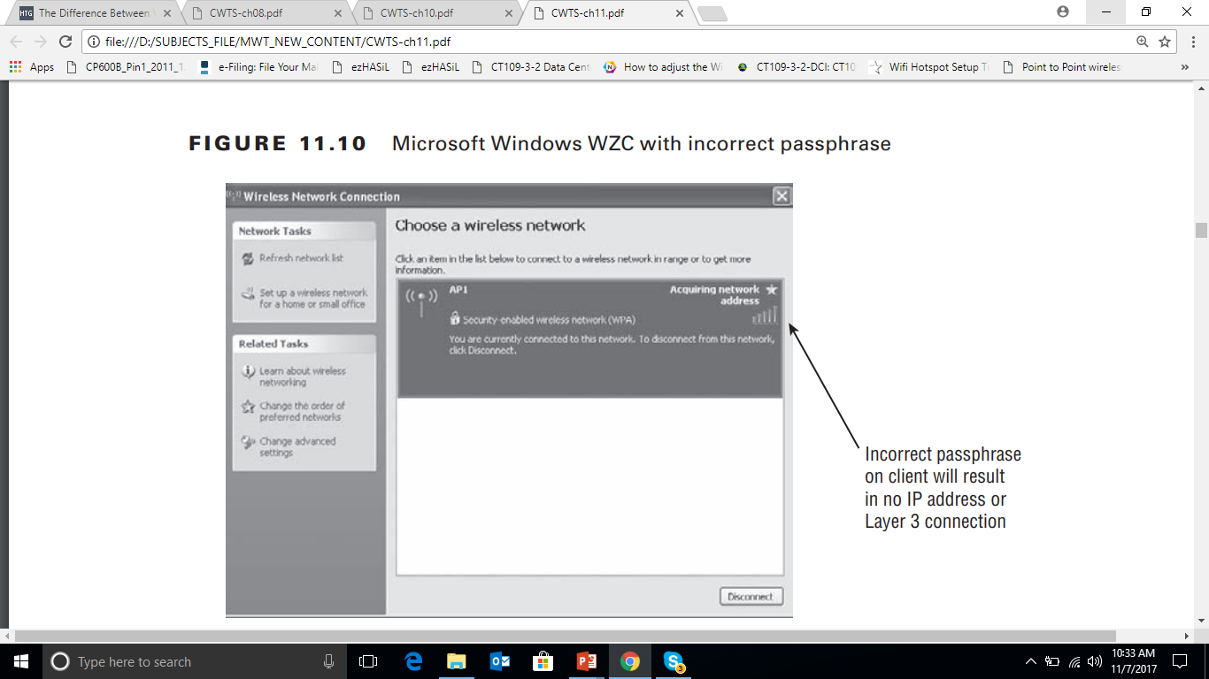
Other Connectivity Issues – Security Settings

Slide 12
Identifying and Maintaining Wireless
Networks
Intermittent Connectivity
Intermittent problems are some of the most difficult to diagnose and repair. they are difficult to diagnose if they can’t be reliably reproduced. Most intermittent connectivity issues in wireless LANs are associated with signal strength.
Weak Signal or No Signal - Weak, low, or no signal is typically an indication that the wireless LAN client device is too far away from an access point or it is experiencing some level of RF interference. In order for a client device to operate correctly, the signal will need to be strong enough to connect to an access point and maintain the connection. A device will have a difficult time distinguishing between signal and noise if the signal level is too close to the noise floor.

Slide 13
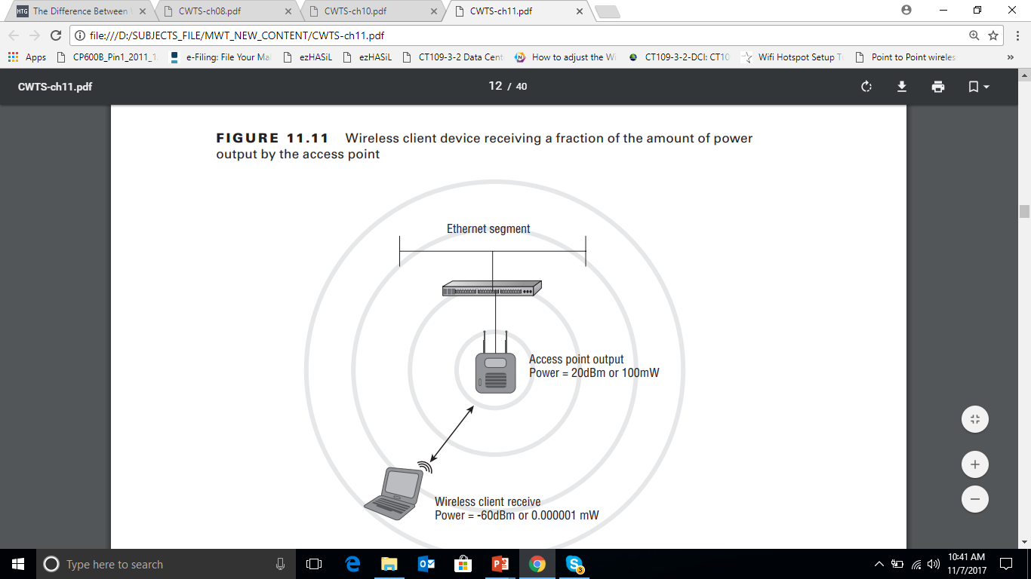
Intermittent Connectivity Issue – Weak or No Signal

Slide 14
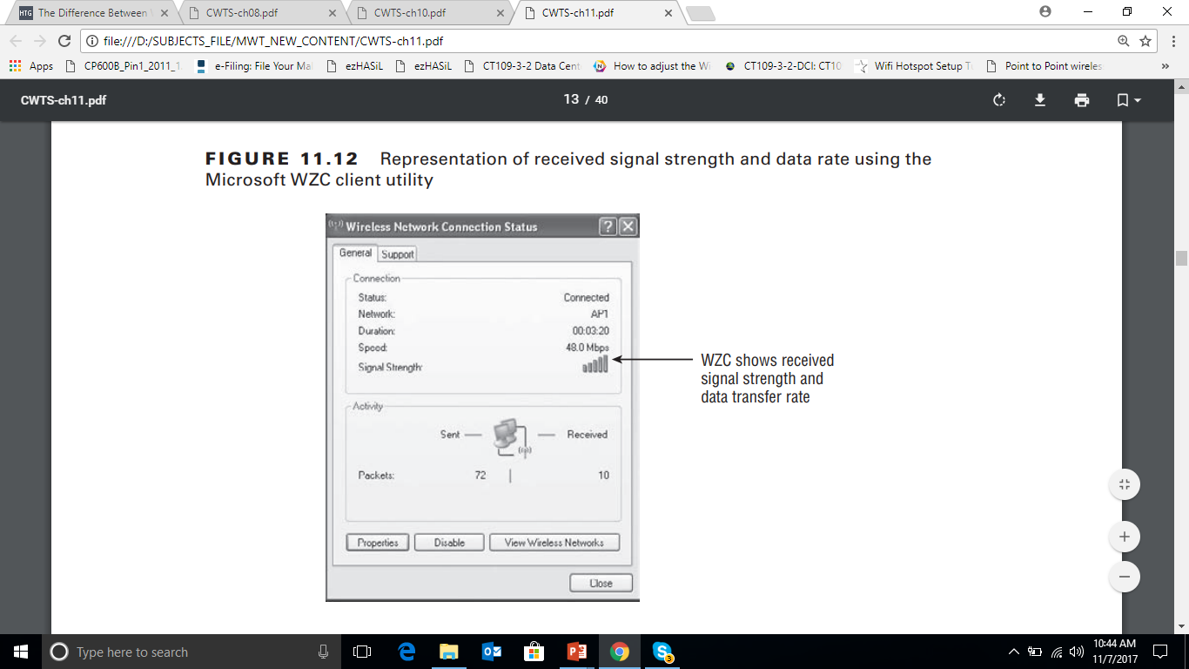
Intermittent Connectivity Issue – Weak or No Signal

Slide 15
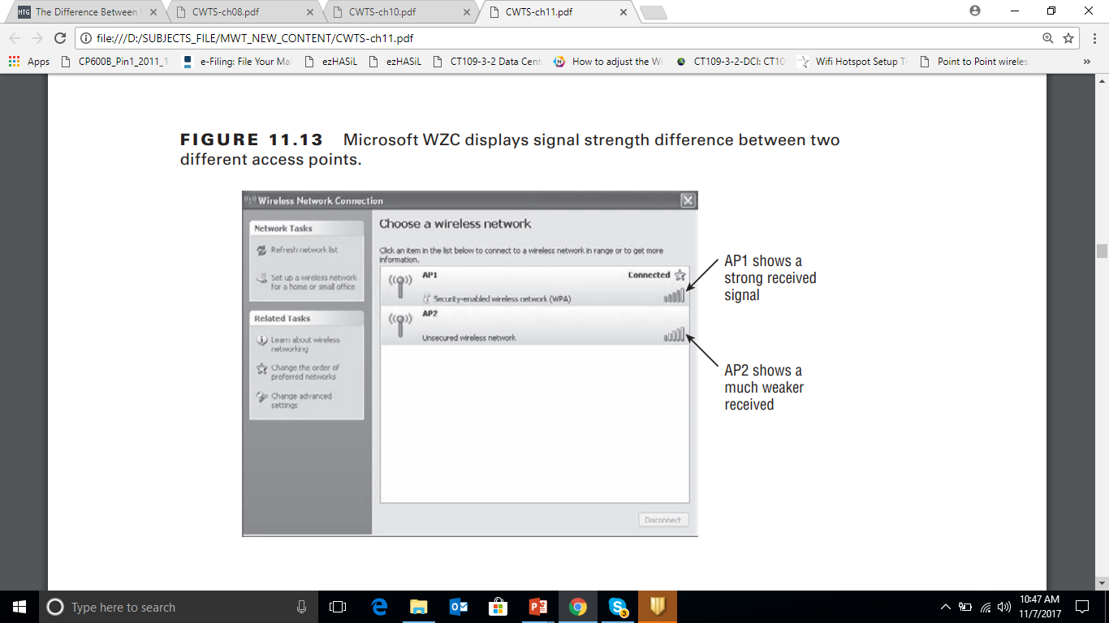
Intermittent Connectivity Issue – Weak or No Signal

Slide 16
Identifying and Maintaining Wireless
Networks
Throughput
It is important to understand the difference between data rate and throughput. It is important for users to realize that the actual throughput will always be lower than the advertised data rate. For example, in an 802.11g network the maximum data rate is 54 Mbps, but the actual throughput will be at best 18 to 22 Mbps, less than half of the advertised data rate.
Several factors may affect the throughput the users are receiving, including:
Distance from access point
Output power of access point
Number of users associated

Slide 17
Identifying and Maintaining Wireless
Networks
Distance from Access Point
As we discussed earlier, as the distance from an access point increases, the signal strength will decrease, thereby providing less average throughput.
Output Power of Access Point
The amount of output power being transmitted from the access point will also determine signal strength for the connected clients. This is because the higher the power, the farther an RF signal will propagate. If a client is receiving a low signal, and adding an additional access point is not an option, increasing the output power of the access point may do the trick.

Slide 18
Identifying and Maintaining Wireless Networks:
Solution
Solutions to low throughput problems include the following:
Adding more access points
Increasing output power of access points
Increasing antenna gain
Enabling load-balancing solutions on access points
One or more of these solutions may help increase the throughput for users connected to a wireless network.

Slide 19
Software and Hardware Upgrades:
Software Upgrade
Software and hardware upgrades play a role in the maintenance and support of any wireless LAN deployment. Upgrading the software related to wireless LAN technology has many benefits that may help resolve performance or operation issues.
It is recommended that technical support or network engineers find time to stay up-to-date with the latest software versions available for the hardware in their network.

Slide 20
Software and Hardware Upgrades:
Software Upgrade
This can be done by looking at the manufacturer’s website or subscribing to a service that will announce changes and updates. Software upgrades for wireless networks commonly fall under three areas:
Device Drivers:
Device drivers are the software components that allow a hardware device to function with a computer operating system.
This is accomplished by the software providing an instruction set for all devices that connect to a computer, handheld, or any other device that runs with an operating system.

Slide 21
Software and Hardware Upgrades:
Software Upgrade
The following list is a small sampling of the devices that will require a software device driver:
Hard drive
Video card
Keyboard
Mouse
USB ports
Network adapters

Slide 22
Software and Hardware Upgrades:
Software Upgrade
With wireless networking, the device driver that is of most concern is the one used for the network adapter.
The wireless network adapter is what allows a computer or other client device to connect to a wireless network in either infrastructure or ad hoc mode.
In addition to causing intermittent connectivity problems, device drivers may become corrupt and prevent the device from starting up. They can even cause operating system startup problems.

Slide 23
Software and Hardware Upgrades:
Software Upgrade
Client Utilities
Client adapter utilities may need to be upgraded occasionally. By upgrading the client adapter utility you will usually add new features or settings to enhance the performance and function of the utility.
Firmware
In basic terms, firmware is software for hardware. Firmware is the instruction set that allows hardware to operate based on its design. Firmware upgrades are common support tasks that need to be done periodically either to fix issues with the way the hardware is operating or to provide new features for the hardware.

Slide 24
Software and Hardware Upgrades:
Hardware Upgrade
Infrastructure Devices
Upgrading infrastructure devices can be an expensive and time-consuming task.
Justifying infrastructure device upgrades may require preparing reports that include performance of the wireless LAN infrastructure and client devices, ones that show how an upgrade will enhance the end-user performance and make users more productive in their job functions.
Upgrading infrastructure devices such as access points may give an organization the ability to enhance the performance of the wireless network by increasing the speed or reliability of the wireless LAN.

Slide 25
Software and Hardware Upgrades:
Hardware Upgrade
The hardware currently in use will help determine the extent of an upgrade. Some upgrades may only require the installation of a new or additional radio.
Antennas:
Unless the physical characteristics of the area where the wireless LAN is deployed have changed since the site survey, chances are that antennas will not need to be upgraded.
If characteristics such as additional walls or types of furnishings or other physical attributes have changed, antennas with different propagation patterns or higher gain may be required.

Slide 26
Software and Hardware Upgrades:
Hardware Upgrade
Another situation where antennas may need to be upgraded or changed is if the initial site survey was not performed thoroughly or correctly.
Client Device Upgrades:
Client device upgrades can be automatic if the technology refresh for devices has taken place. For example, if a company replaces 50 notebook computers with newer models, the new notebooks will probably have wireless LAN adapters that are capable of 802.11a/g/n.
The capabilities of these new notebooks may be more advanced than the actual infrastructure that is currently deployed.

Slide 27
Software and Hardware Upgrades:
Hardware Upgrade
Another situation where wireless client devices may need upgrading is one in which the infrastructure changes to different hardware or technology.
If a company upgrades access points from 802.11b to 802.11g and the clients only support 802.11b, the client devices may need to be upgraded in order to take full advantage of the new wireless infrastructure.

Slide 28
Optimizing Wireless Networks
Making necessary changes to a wireless LAN installation may be required in order to provide optimal performance for the devices that will be connecting. In some cases, a site survey is considered an ongoing process due to the dynamics of radio frequency and changes in technology. This being the case, an existing wireless LAN deployment may need to be resurveyed to provide optimal performance for the users. Listed are some of the things that need to be taken into consideration when optimizing a wireless LAN:
Hardware selection and placement
Interference sources
Load balancing
Capacity and utilization

Slide 29
Optimizing Wireless Networks :Infrastructure Hardware Selection and Placement
Although the objective of a site survey is to design the network, find locations and sources of interference, and decide on locations for infrastructure devices, it may be necessary to make some adjustments to allow for optimal performance.
This may include minor relocation of access points as well as radio frequency adjustments, including channel and output power settings. These adjustments would ensure clients have maximum signal strength, throughput, and roaming capabilities.
Applications—both hardware and software—and user requirements could also change, requiring an optimization or resurvey of the wireless network.

Slide 30
Optimizing Wireless Networks:
Identifying, Locating, and Removing Sources of Interference
This usually is part of the site survey process. Probably the best way to identify sources of interference is with a spectrum analyzer. This could be in the form of an instrumentation device or a PC card–based spectrum analyzer designed specifically for wireless networking.
During this site survey process, interference sources should be identified.
How ever, changes to the environment may introduce new sources of RF interference. Also, keep in mind that a walkthrough spectrum analysis of an area will only record the RF it sees at that instant in time.

Slide 31
Optimizing Wireless Networks:
Identifying, Locating, and Removing Sources of Interference
If a new piece of equipment is introduced into an area, it may cause interference with the wireless network that would not have been present during the RF site survey spectrum analysis process. Some businesses or organizations where this could be a factor include:
Health care
Warehouse/retail
Manufacturing
Industrial

Slide 32
Optimizing Wireless Networks:
Identifying, Locating, and Removing Sources of Interference
Therefore an ongoing spectrum analysis may be required to identify and if possible
remove the sources of interference. If these new sources of interference are there to stay, it will be necessary to make appropriate adjustments for the network to operate as designed.
The number one source of interference in a wireless network is other wireless devices.

Slide 33
Optimizing Wireless Networks:
Client Load Balancing
Client Load Balancing : Client load balancing is a mechanism that prevents wireless client devices from associating to an access point that has already reached the maximum number of client devices for optimal performance.
There are a variety of ways this can be accomplished, typically vendor specific. Parameters for load balancing can be set on either the access points or the wireless LAN switch/controllers.

Slide 34
Optimizing Wireless Networks:
Client Load Balancing
Load balancing will allow for optimal use of all access points in a specific area by preventing too many devices from connecting to a single access point.
The way in which load balancing is implemented depends on the manufacturer of the wireless LAN equipment. One solution is a settable parameter in an access point specifying a maximum number of devices allowed to connect at any one time.
Once the access point has reached its capacity, a client device wanting to associate will be presented with an error message and will not be allowed to complete the process.

Slide 35
Optimizing Wireless Networks:
Analyzing Infrastructure Capacity and Utilization
It is important to have a baseline for the performance of your wireless LAN. This baseline will show the average utilization and capacity of the connected infrastructure devices at various times during the company’s business hours.
Continuous monitoring of the wireless network is similar to that of a wired network. Performance metrics will be needed to gauge the use of the wireless LAN and infrastructure devices and show how well the system performs.
These metrics will also show areas that are lacking in performance, including bottlenecks or over-utilized access points. Using these performance metrics will show which infrastructure devices need attention.

Slide 36
Optimizing Wireless Networks
This may include moving or adding access points for additional capacity or to allow for higher utilization. Changes to the environment, such as the addition of users, may justify the need for additional access points.
Multipath
Poor throughput can be the result of corrupted data, which may be caused by multipath. Multipath is various RF wave fronts of the same signal being received at slightly different times. Multipath is caused by RF reflections based on the physical attributes where an access point is placed.

Slide 37
Optimizing Wireless Networks
Hidden Node
Hidden node is the result of client devices connected to an access point and not able to “hear” each other prior to starting a transmission. This will result in collisions at the access point and lost data.

Slide 38
Quick Review Question
How to optimize wireless networks?
What are the solutions to low throughput problem?
What is client load balancing?

Slide 39
Summary of Main Teaching Points
In this chapter, we discussed some troubleshooting and maintenance concerns that may involve wireless networking.
We discussed some of the factors that could cause low throughput and how to solve these issues. Upgrading software is another area that needs be taken into
consideration with wireless LANs from the client side, upgrading device drivers or client software utilities, as well as the infrastructure side, which includes upgrading firmware.
Finally, we looked at optimizing wireless networks and some of the areas that should be considered for this optimization, which may include making the necessary adjustments from the original wireless site survey.

Slide 40
Question and Answer Session
Q & A

Slide 41
What we will cover next
WiMAX and LTE
2G, 3G, 4G, 5G
Key Network Technologies
Network Architecture
Mobile WiMAX versus WiFi
Mobile WiMAX Versus Cellular Mobile Networks

